Slide 1


Slide 2

T1 Presenter
RealtTime 3D Presentation Tool

Slide 3
Convert 2D -> 3D Presentations
Convert Existing 2D presentations to 3D
Easy to Adapt and start doing 3D Presentations
Impress and Engage with your audience

Slide 4
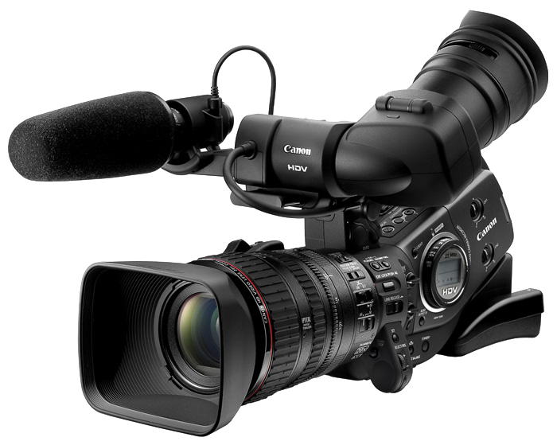
RealTime Lights and Camera Movements
Enrich using RealTime Lights and Camera
Customizable camera points
Make your Images projected

Slide 5
Sample Images
Let’s Dive Straight

Slide 6


Slide 7
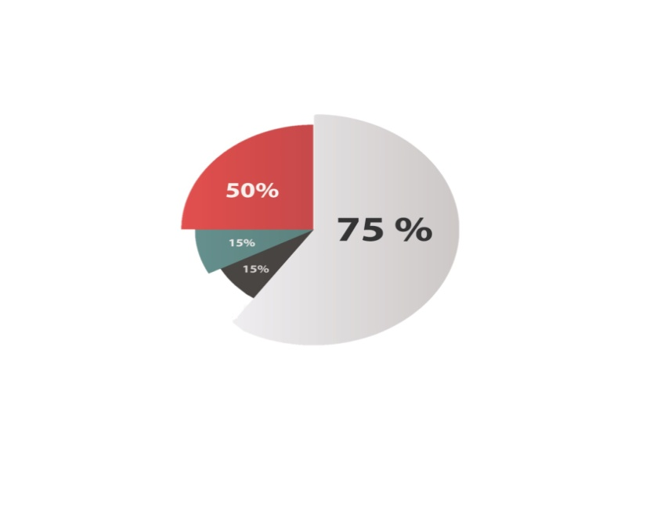

Slide 8
Sample Subjects

Slide 9

Physics

Slide 10
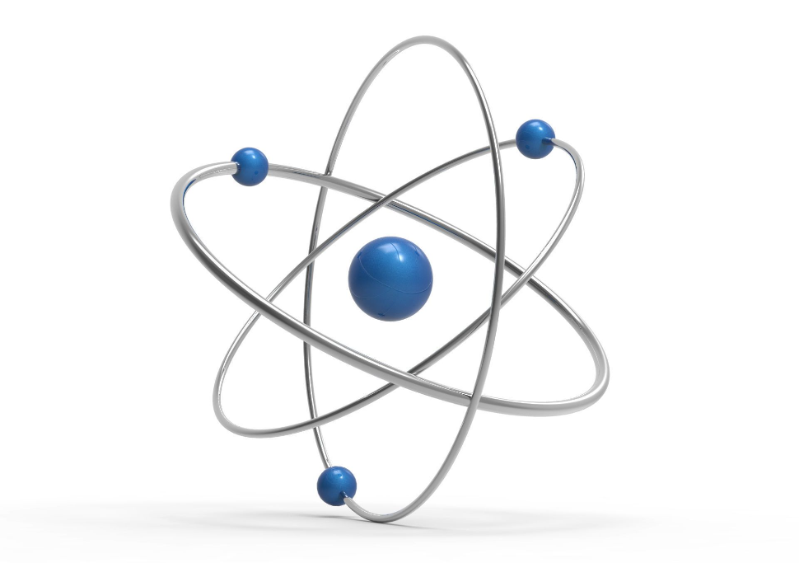
Atom

Slide 11
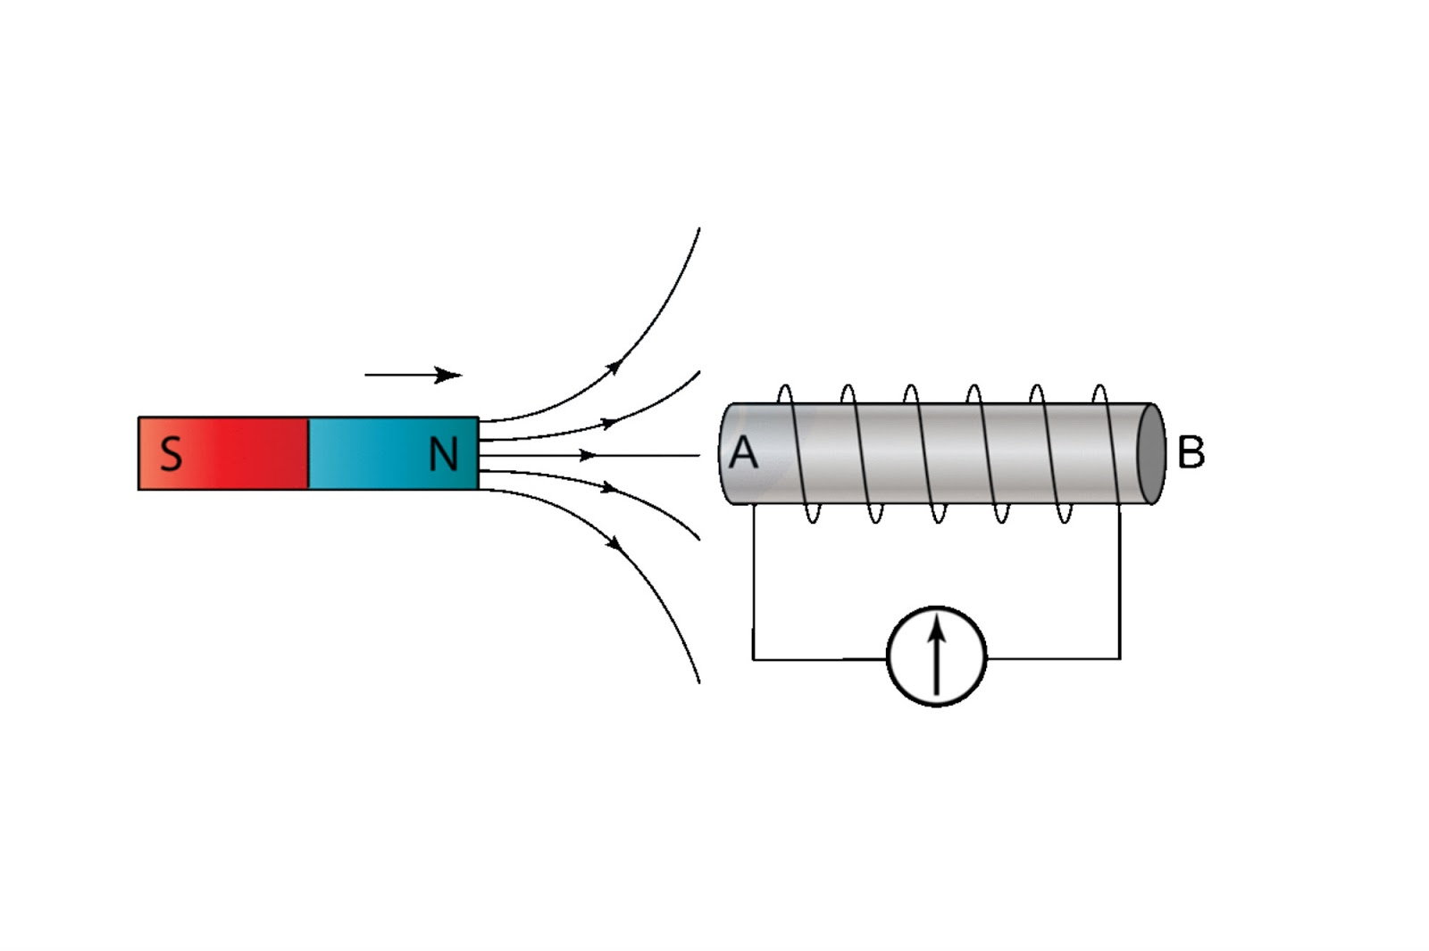
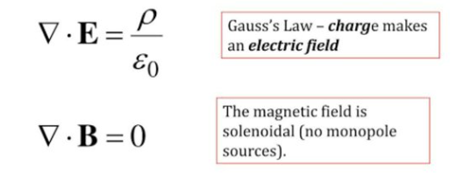
Electro_Magnetism
A moving magnet towards a solenoid

Slide 12
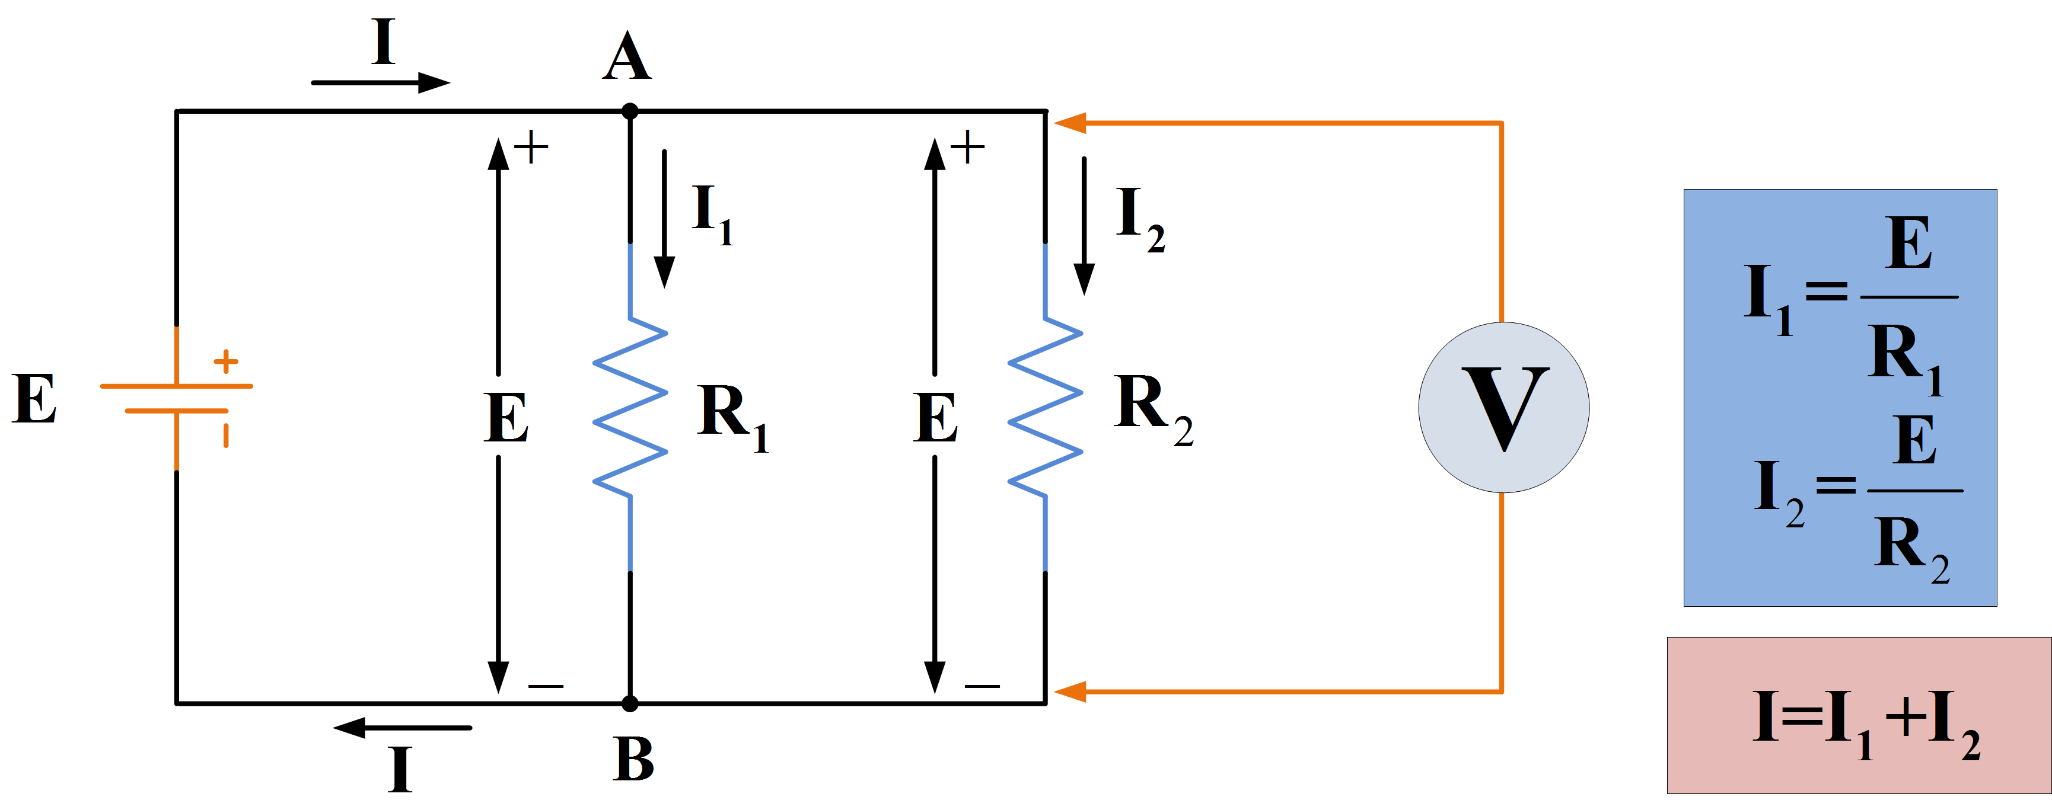
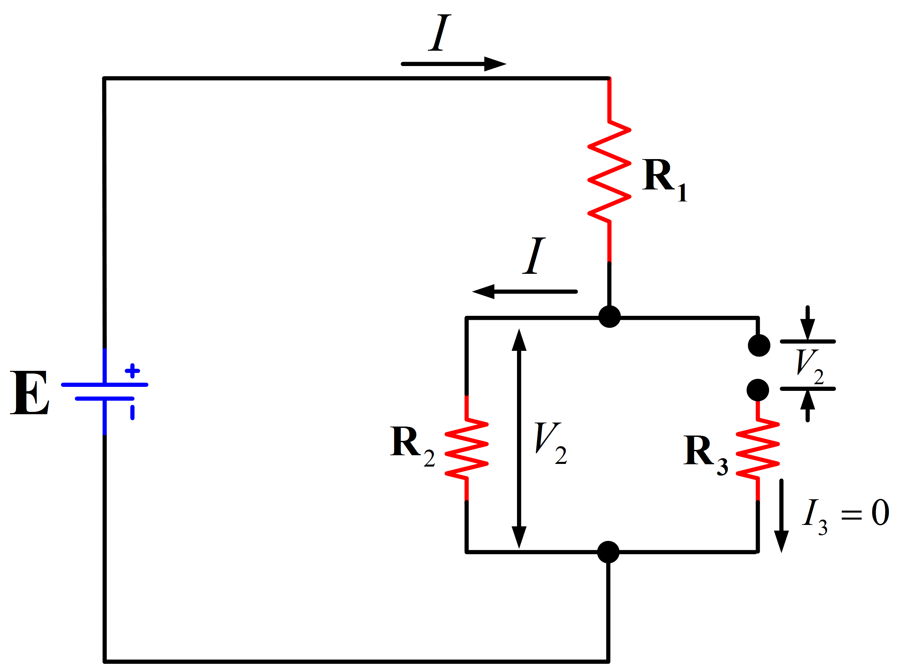
Electronic Circuit
Parallel Circuit
Series Circuit

Slide 13
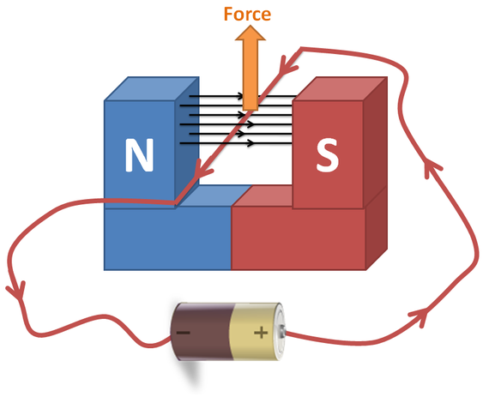
Flemings Left Hand Rule
If we arrange our thumb, forefinger and middle finger of the left hand perpendicular to each other, then the thumb points towards the direction of the magnetic force, the forefinger points towards the direction of the magnetic field and the middle finger points towards the direction of the current.

Slide 14
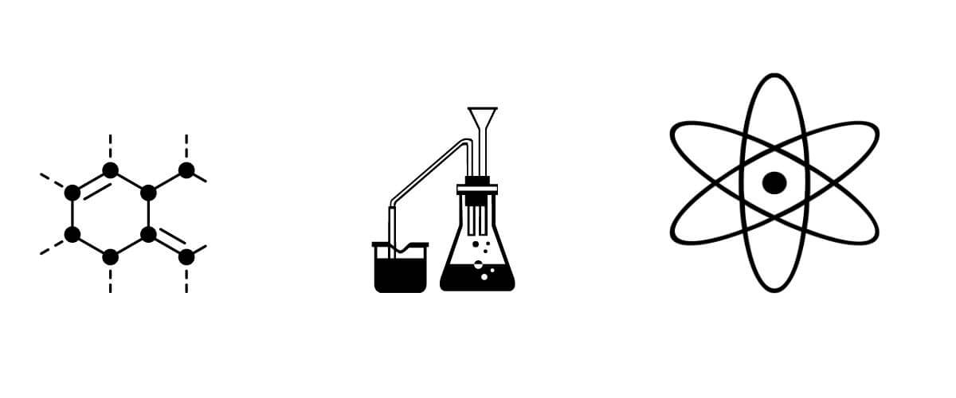
Chemistry

Slide 15
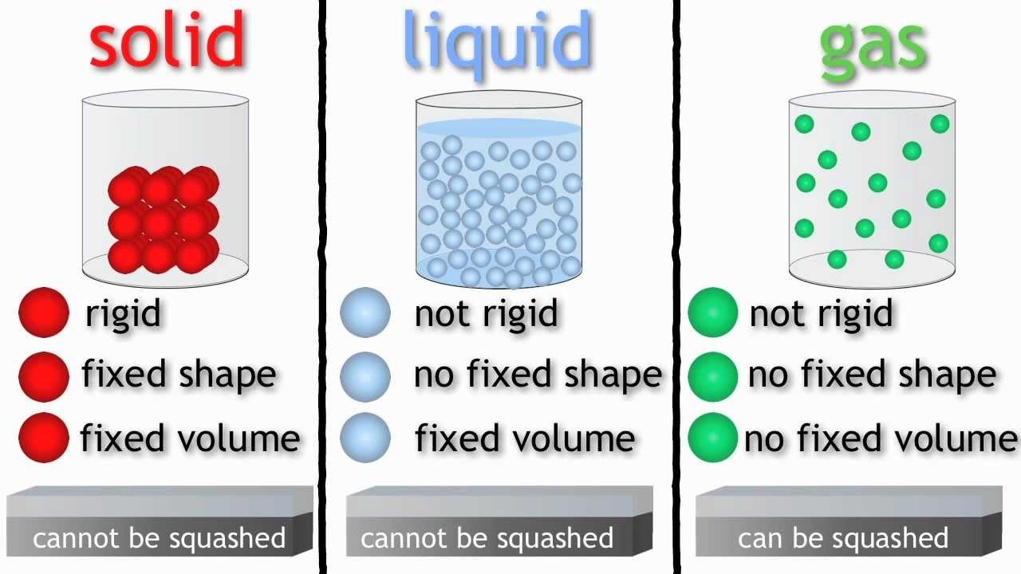
Solid State

Slide 16
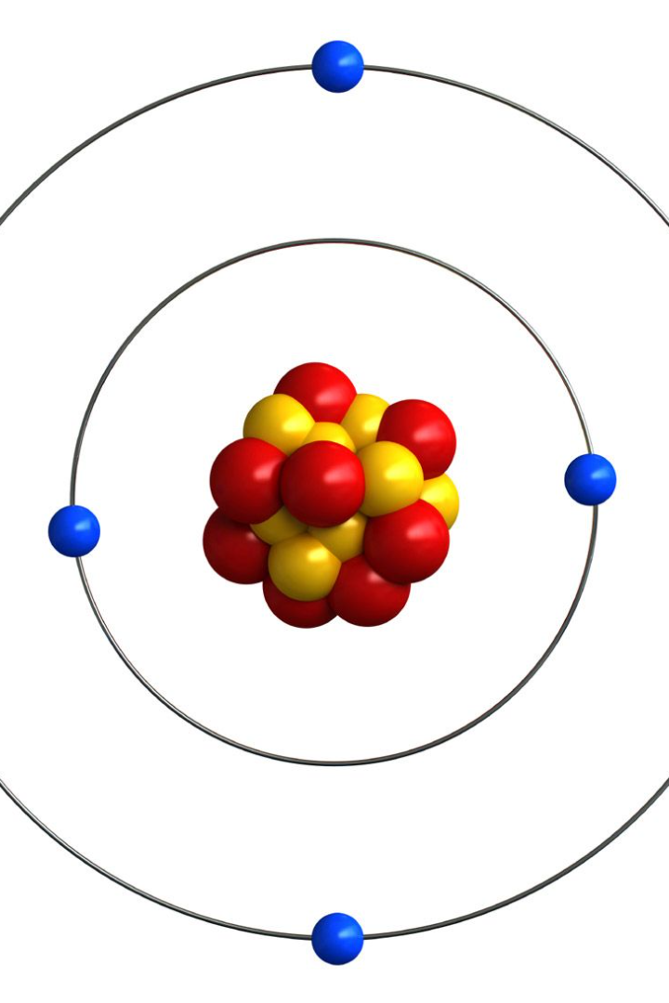
Nucleus Model

Slide 17
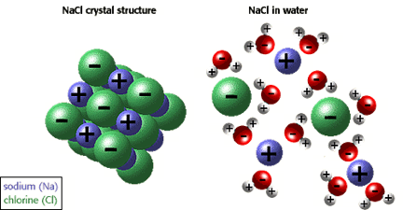
Intermolecular Forces
Packed Structure UnPacked Structure

Slide 18

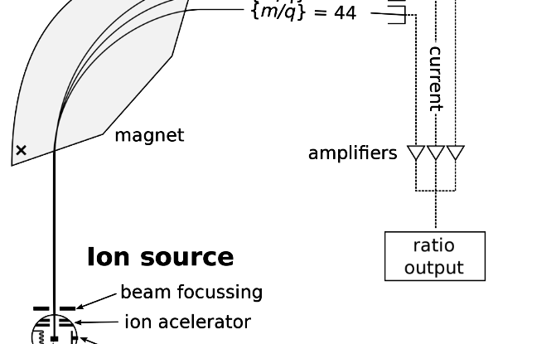
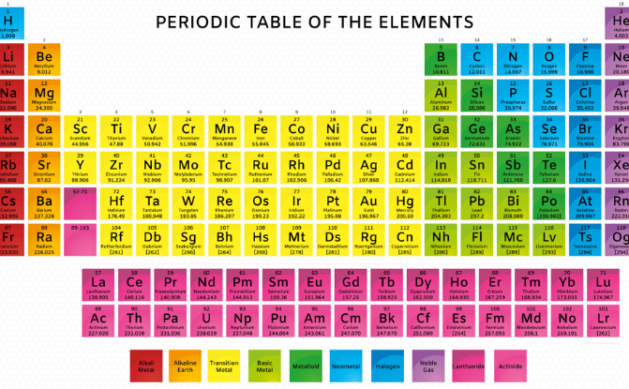
Isotopes and Atomic Mass
Mass Spectrometry
Atomic Weight
A technique used to determine the atomic and molecular mass of particles by measuring the mass-to-charge ratio of ions in a sample.
The average relative atomic mass of an element based on all the naturally occurring isotopes of that element.

Slide 19

Biology

Slide 20
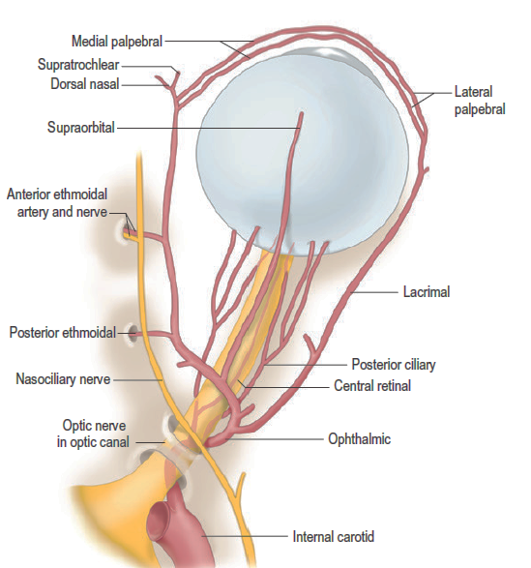
Blood Vessels
Arteries
Ophthalmic artery, a branch of internal carotid artery, supplies blood to the eyeball and other orbital structures

Slide 21
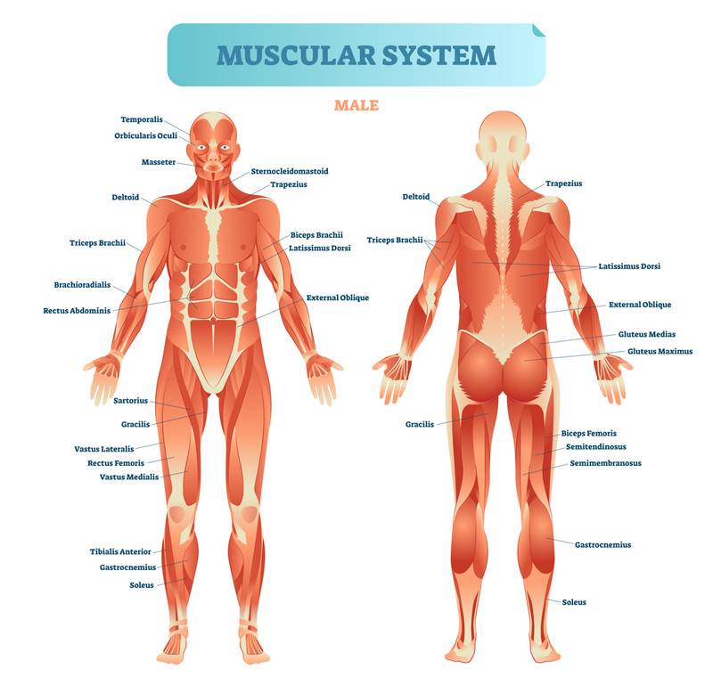

Slide 22
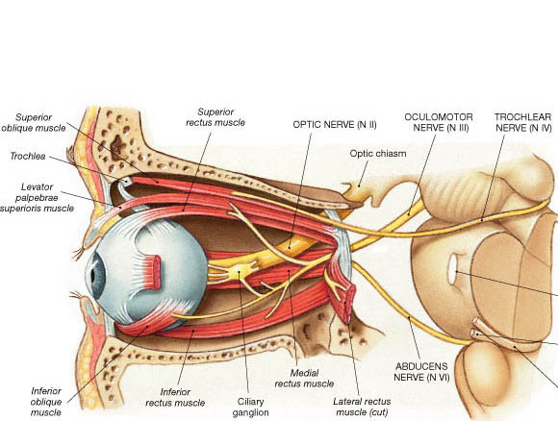
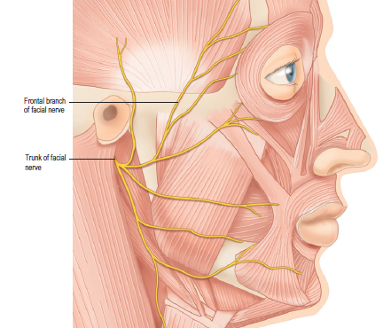
Eye Anatomy

Slide 23
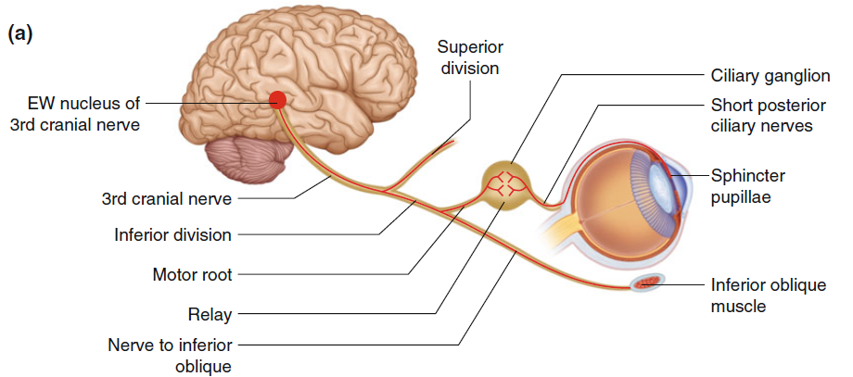
Brain’s connection to Eye

Slide 24
Maths

Slide 25
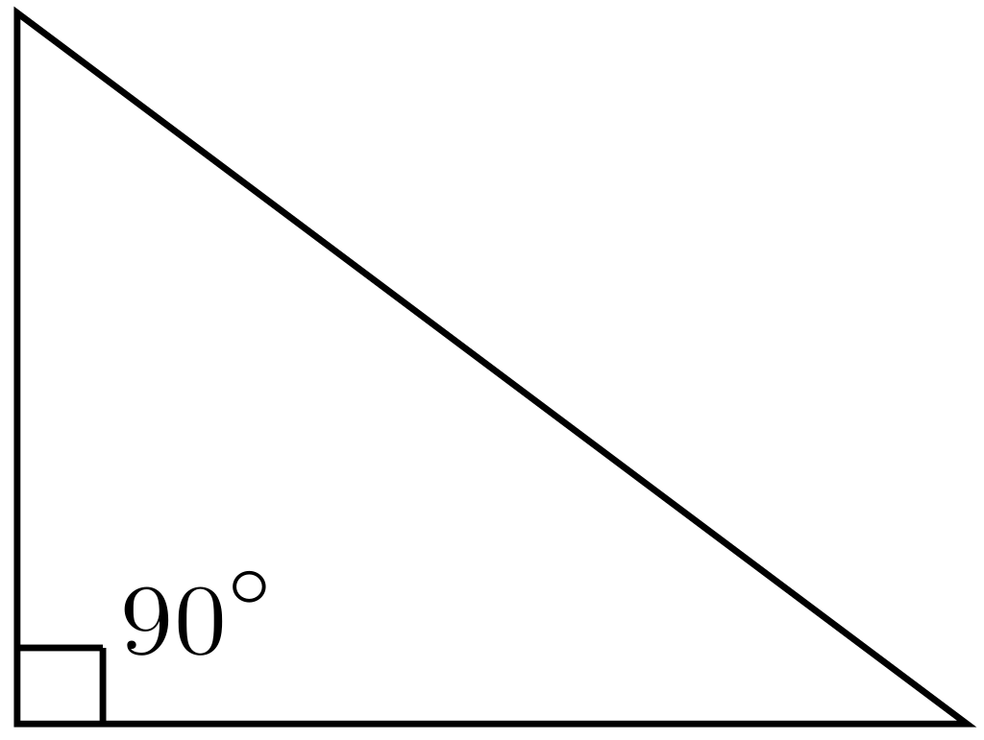
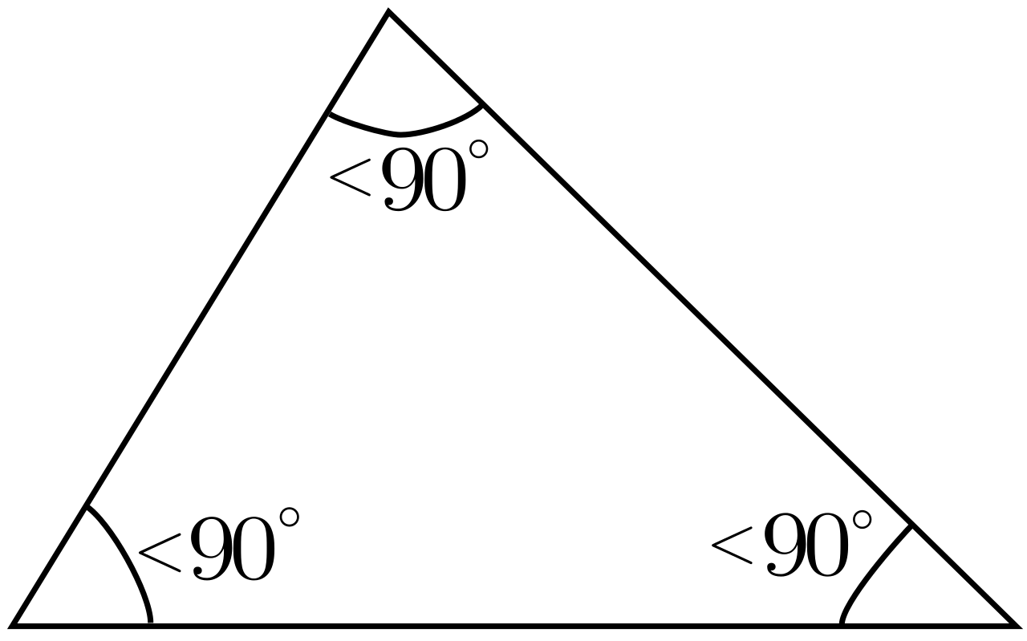
Geometry

Slide 26
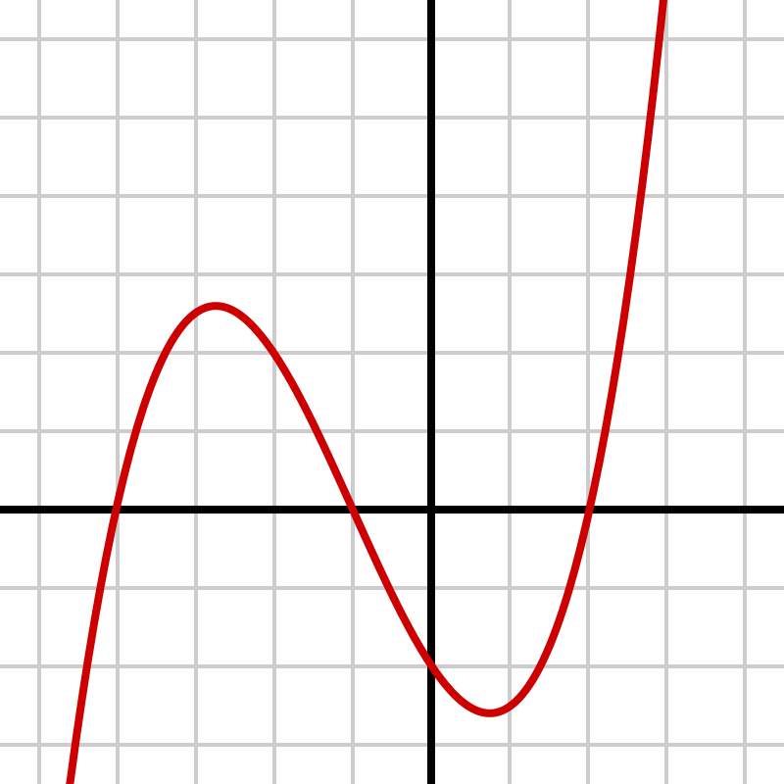
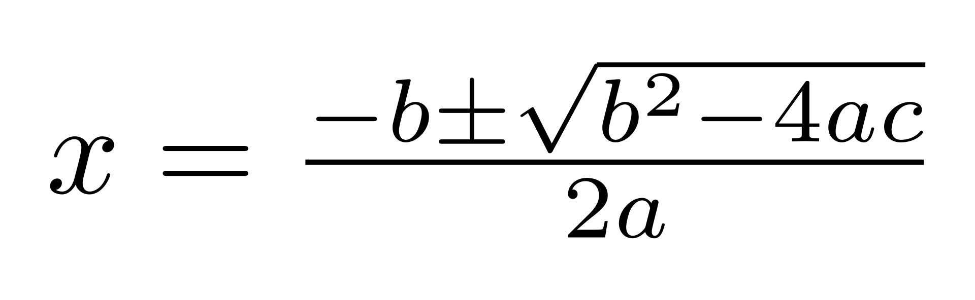
Algebra

Slide 27
Solving Equations
15 – 4x = 2(3x + 1)
15 - 4x – 6x = +2
-10x = 2 -15
-10x/-10 = -13/-10

Slide 28
Moving to Next Ppt

