Slide 1

T1 Presenter
RealtTime 3D Presentation Tool

Slide 2
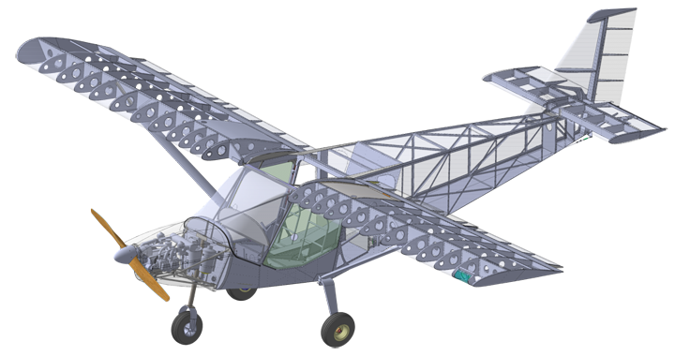
Mechanical CAD

Slide 3
Introducing Multiple Window
You Can introduce more than one Windows
Don’t have to switch between windows

Slide 4
Computer Science Algorithms
Explain Programming interactively
Let’s write a program to compute Cube Square Area
Input
Process
Output

Slide 5
Include Excel and Charts

Slide 6
Pie Chart

Slide 7
Include Videos
Now Include Videos in the Same Set and Switch Seamlessly
https://www.youtube.com/watch?v=xfbtABdK5S8

Slide 8
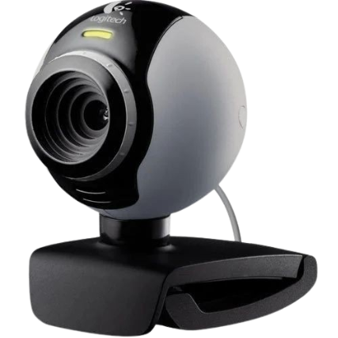
Record or Stream Online
Include Cameras for online meeting
Record it into videos or Stream

Slide 9
More Interactive
Move Back and Forth for more interactivity
Conduct Quizzes hiding at will
More Visual Engagement

Slide 10
Thank You

